Slide 1
Text Analytics
Topic- Analysis of BLS(Bureau of Labor Statistics) employment Reports to understand U.S Labor Market Trends
By – Prashanth, Amaan, Satwika & Mrudhula

Slide 2
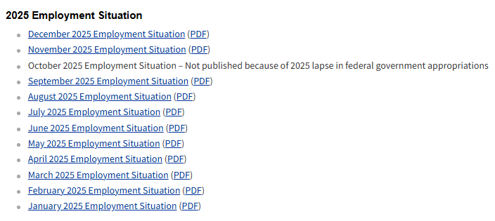

Introduction
BLS Publish Monthly Employment Reports
Which includes job growth, unemployment rates ,etc.
By analyzing the wordings and key terms used in BLS reports we can get idea how the labor market changed across time period
Data we are working on
2016 Jan – 2026 Feb

Slide 3

01
Data Collection & cleaning
BLS employment report(our main text report.)
FRED Unemployment rate data(labor market condition indicator)
Cleaning(punctuation, stopwords, numbers, etc).
tokenization and stemming, Lemmatization.

Slide 4
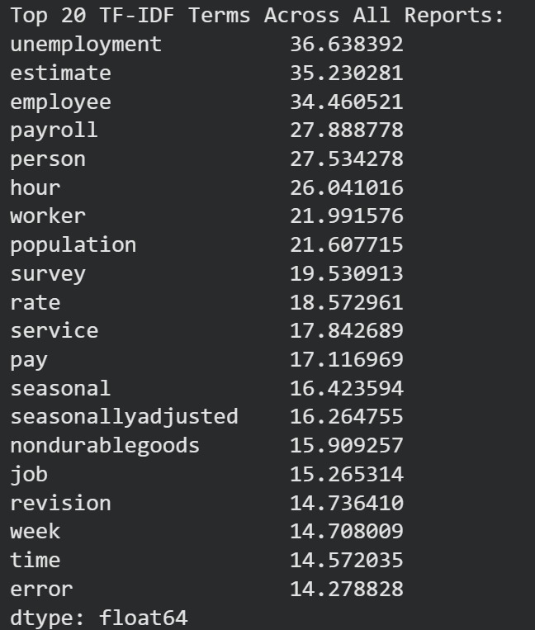
Analysis
Word frequency Analysis
TD-IDF Analysis -

Slide 5
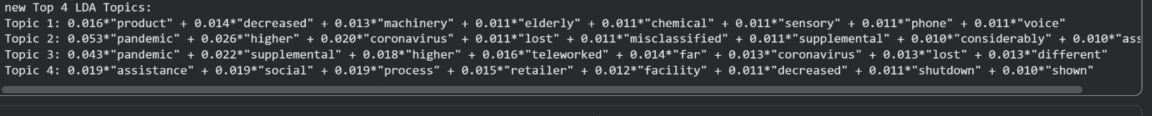
Topic 1- related to manufacturing
Topic 2 – Pandemic employment impact
Topic 3- Remote Work & pandemic

Slide 6
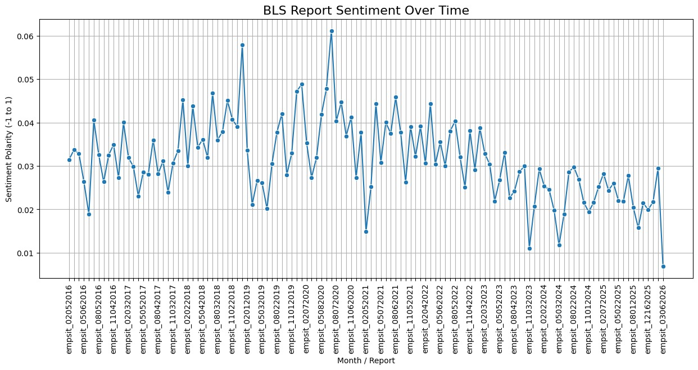
Sentiment Analysis

Slide 7
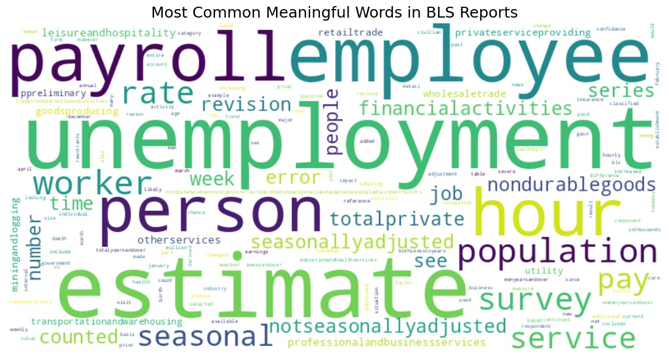
Word Cloud

Slide 8
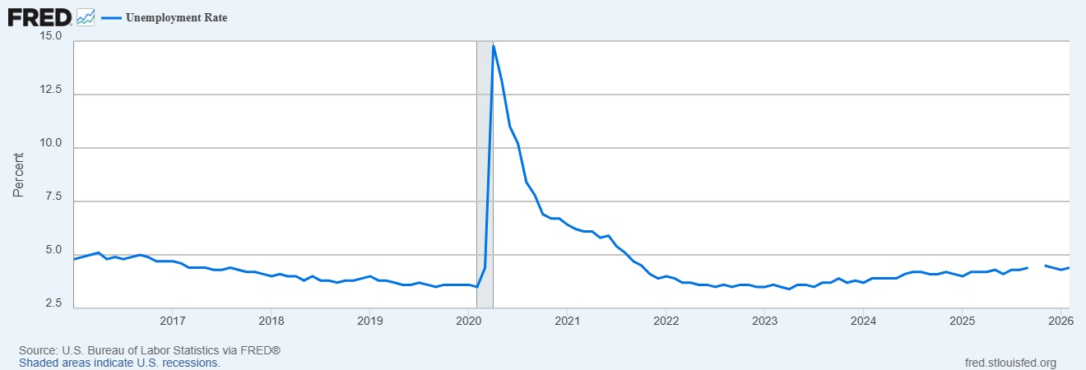
Federal Reserve economic Data

Slide 9
Suggestions
Latent Dirichlet Allocation(LDA)- Identifying main themes across reports.
Sentiment Anlysis – using Positive vs negative analysis
Logistig regression model – Predicting labor market sentiment

Slide 10

Summary
Challenge – Data itself.
Analysis was done good.
Further, We need to even collab CPI(consumer price index) to better create trends.

Slide 11
Thanks!
Do you have any questions?

